Slide 1
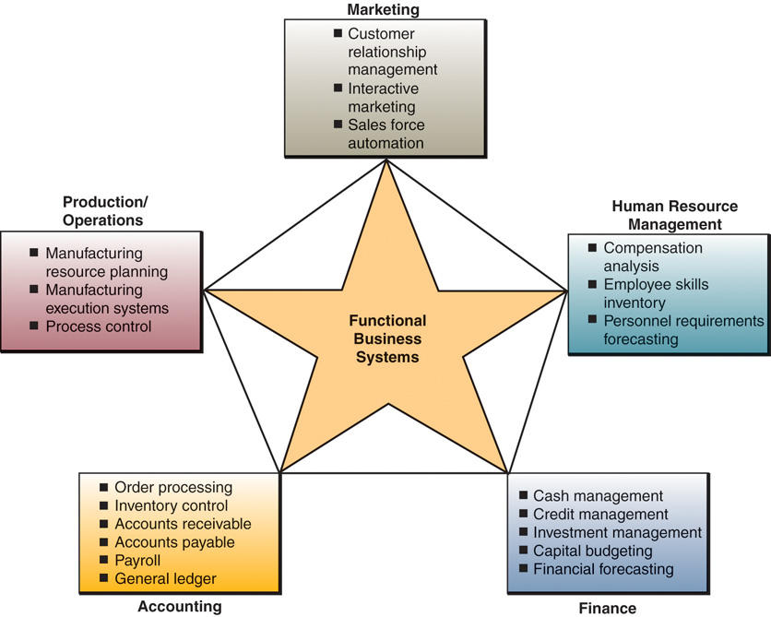
Functional Business Areas

Slide 2
The Variety of IS that support the Business Function
The Marketing information system function supports traditional and e-commerce process and management of the marketing functions Major type of marketing information system includes interactive marketing sales force automation, customer relationship management, advertising and targeted marketing.
The Manufacturing system supports the computer based manufacturing that helps a company achieve computer integrated manufacturing and auto mate the various activities in planning and scheduling of production and operations management activities.
Human resource Management system that supports the various HR functions performed by the HR Manager systematically supported by the system more effectively. Personnel policies implementation, Training and development functions, staffing and compensation plans and everything performed effectively by the HR System.
Accounting and Finance that supports record, report an analyze the all accounting activities of various cash disbursements and all the credit activities with the effective systemized activity of General ledger system and it also helping to analyze various activities like capital budgeting, and ratio analysis and various in different activities of accounting dimensions of cash flow and fund flow of all the periodical dimensions.

Slide 3
Marketing Information System
Marketing information system supports the marketing manager to perform the following functions effectively,
Customer relationship Management
Product Planning
Pricing
New Product development strategies
Advertising and Sales promotion
Targeted Marketing
Sales force management etc.,

Slide 4
Manufacturing Systems
Manufacturing systems supports the production and operational function that includes all activities concerned with the planning and control of the processes providing goods and services. Thus the production and operations functions are concerned with the man agent of the operational process and systems of all business firms.
A variety of manufacturing process many of them,-web enabled, are used to support Computer Integrated Manufacturing (CIM) Computer Integrated Manufacturing such as follows.
Manufacturing Resource Planning Systems
Manufacturing Execution system
Engineering Systems
The over all CIM and such manufacturing information systems is to create flexible agile manufacturing process that efficiently produce products of the higher quality. Thus CIM supports the concept of flexible manufacturing system
The following Manufacturing information system support computer integrated manufacturing resource planning system are not one of the application culture in an ERP system program. The diagram explains how the manufacturing system helping to simplify and automatically integrate the manufacturing process of a manufacturing unit.

Slide 5
HR Information System
Thus the Human Resource System are designed to support the following functions:-
Planning to meet the personnel functions of the business.
Development of employees to their full potential
Control of Personnel policies and program.
Use of computerized personnel management system helping to assist paychecks and payroll reports, Maintain personal records, Analyze the use of personal in business operations
The overall Human Resource Information system support the following functions effectively,
Recruitment and Selection
Job placement
Performance appraisal
Employee benefit analysis system
Training and development
Health, Safety and Security measures

Slide 6
Accounting Information systems
Accounting information systems are the oldest and most widely used information systems in business.
Accounting information system are organized the double entry book keeping concept
Computer based Accounting system record and report the flow of funds through on future course of action.
Systems also helping to produce order processing inventory control, accounts receivable ,accounts payable , payroll, and general ledger systems. Management accounting system focus on the different budget preparation, Fund flow sheet, cash flow sheet, and the ratio analysis. The cost accounting system helping to trace out the cost estimation through cost sheet and standard costing.

Slide 7
Accounting Information systems
Online Accounting System- The accounting information system focuses using internet, intranet extranet and other net work changes how an accounting information system monitor the business activity. The online, interactive nature of such networks calls for few new forms of transaction documents, procedures, and controls.
Inventory Control System- That process data reflecting changes to the items in inventory . Once data about consumer orders are received from an order processing system a computer based inventory system records changes to inventory status, reports thus help a business provide high quality service to consumers
Accounts receivable System:- That keeps the data records of amount owed by customers, from data generated by customer purchases and payments.
They produce invoices to customers monthly consumer statements and credit report management.

Slide 8
Accounting Information systems
Accounts Payable system:-
This system keeps track of data concerning business purchases from and payment to suppliers. They prepare checks in payment of outstanding invoices and produce cash management reports. Computer based accounting payable system help to ensure prompt and accurate payment of suppliers to maintain good relationship.
Pay roll System
Pay roll system receive and maintain data from employee time cards and other work to words paychecks and earning statements payroll reports, and labor analyze report to determine accurate reports.
General Ledger:-
General ledger system consolidates the data received from accounts receivable, accounts payable, pay roll and other information system . At the end of the each accounting period they close the books of business and various income statement and balance sheet of the firm. And various income and expenditure statements of the Business. They typically provide better financial control and management reports and involve fewer personnel and lower cost than manual accounting methods.

Slide 9
Financial Management System-
Major financial management system categories include cash management and investment management , financial forecasting and financial planning
Cash Management –System collect information on all cash receipts and disbursements within a company on a real time or periodic basis. Such information allows business to deposit or invest excess fund quickly and these increase the income generated by deposited or invest funds. These system also produce daily , weekly, monthly forecasts the cash receipts or disbursements.
Online Investment Management:-Many business invest their excess cash in short term low risk market able securities. So that investment income may be earned until the funds are required. The portfolio of such each securities can be managed with the help of security management software packages. Online investment services help a financial manager make buying, selling, or holding decisions for each type of security so that an optimum mix of securities is developed that minimize risk and maximize investment income for the business.
Capital Budgeting:-This is a process involves evaluating the profitability and financial impact proposed capital expenditures. Long term expenditure proposals for plant and equipment can be analyzed using a variety of techniques. This application makes heavy use of spread sheet model that incorporate corporate present value models.

Slide 10
Financial Management System-
Financial fore casting and planning :
Financial analysis typically use electronic spread sheets and other financial planning soft ware to evaluate the present and past projected financial performance of a business and analyze alternatives methods of fore casting . Financial analysis use financial forecasting concerning the economic situation, business operations types of financing available, interest rate, and stock bond prices to develop on optimum financial plan for the business.
Electronic spread sheets, DSS software and web based groupware can be used to build and manipulate financial statements. And need to develop the business operations. The web based group ware can be used to build and manipulate financial models
The optimal financing plan for the business and activities answers to goal seeking questions Can be explored as financial analyst and manager evaluate that financing and investment alternatives

Slide 11
Transaction processing System
Transactions are events that occur as part of doing business such as sales, purchases deposits withdrawals, refunds, and payments. Think for example the data generated whenever a business something on credit whether in a retail store or at an e-commerce site on the web, Data about customer, product, salesperson, stores and so on, must be captured and processed.
Online Trans action Processing play a strategic role in electronic commerce. Many firms are using the internet, Intra net, extranet and other net work that can be made electronically to process the transactions.

Slide 12
Transaction Processing Cycle
Data entry:- The first step of trans action processing cycle in the capture of business data. For example transaction data may be collected by point of sales terminals using optical scanning of barcodes and credit card readers of a retail shop
Trans action processing:-Trans action processing systems produce data in two basic ways:-Batch processing-Where trans action data are accumulated over a period of time and processed periodically and Real time processing-where data are processed immediately after a transaction occurs. All online transaction processing system incorporate real time processing capacities.
\Data maintenance:- An organization database must be maintained by the trans action processing system so that they are always correct and up to date . Therefore transaction processing system update all the necessary information reflect the day to day operations.
Document and Report Generations:- TPS provide a variety of documents and reports. Example, purchase orders, sales receipts, invoices, and all the customer statements. Transaction processes reports might take the form of a transaction lists such a payroll register. And or the edit reports detected during processing.
Inquiry Processing:- Many trans action processing system allows you to use the internet, intranet, extranet and web browser or data base management query languages to make enquiries and receive responses concerning of transaction processing activity.

